Slide 1
5G Edge Cloud

Slide 2

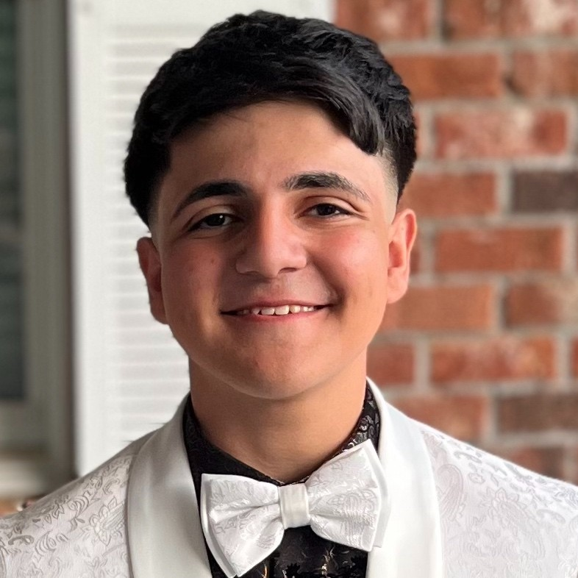
Team Members
Rahul Rajkumar
Andrew Michael

Slide 3
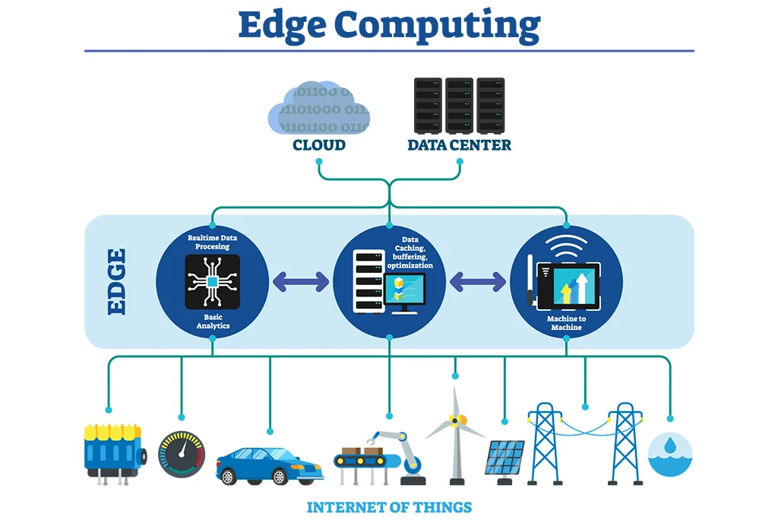
Review
What are we working on: Edge
What are we doing: Creating Benchmarks

Slide 4
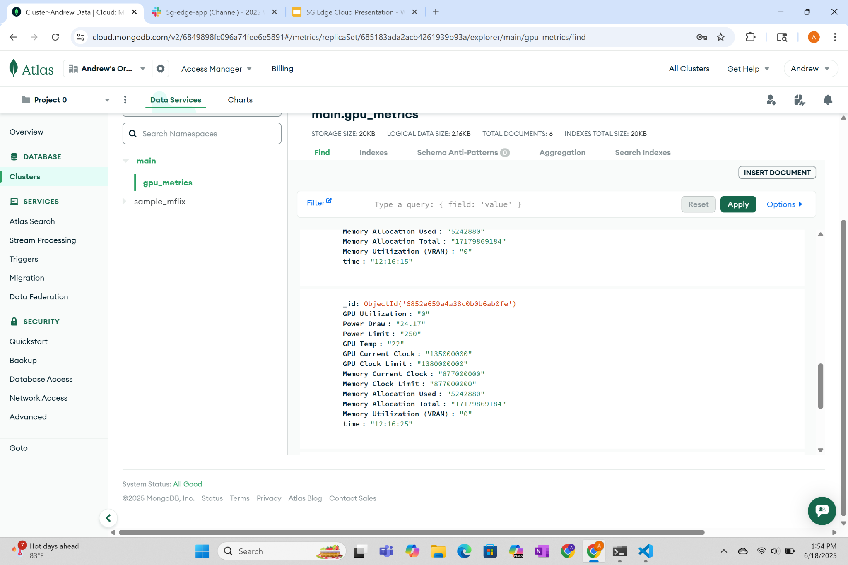

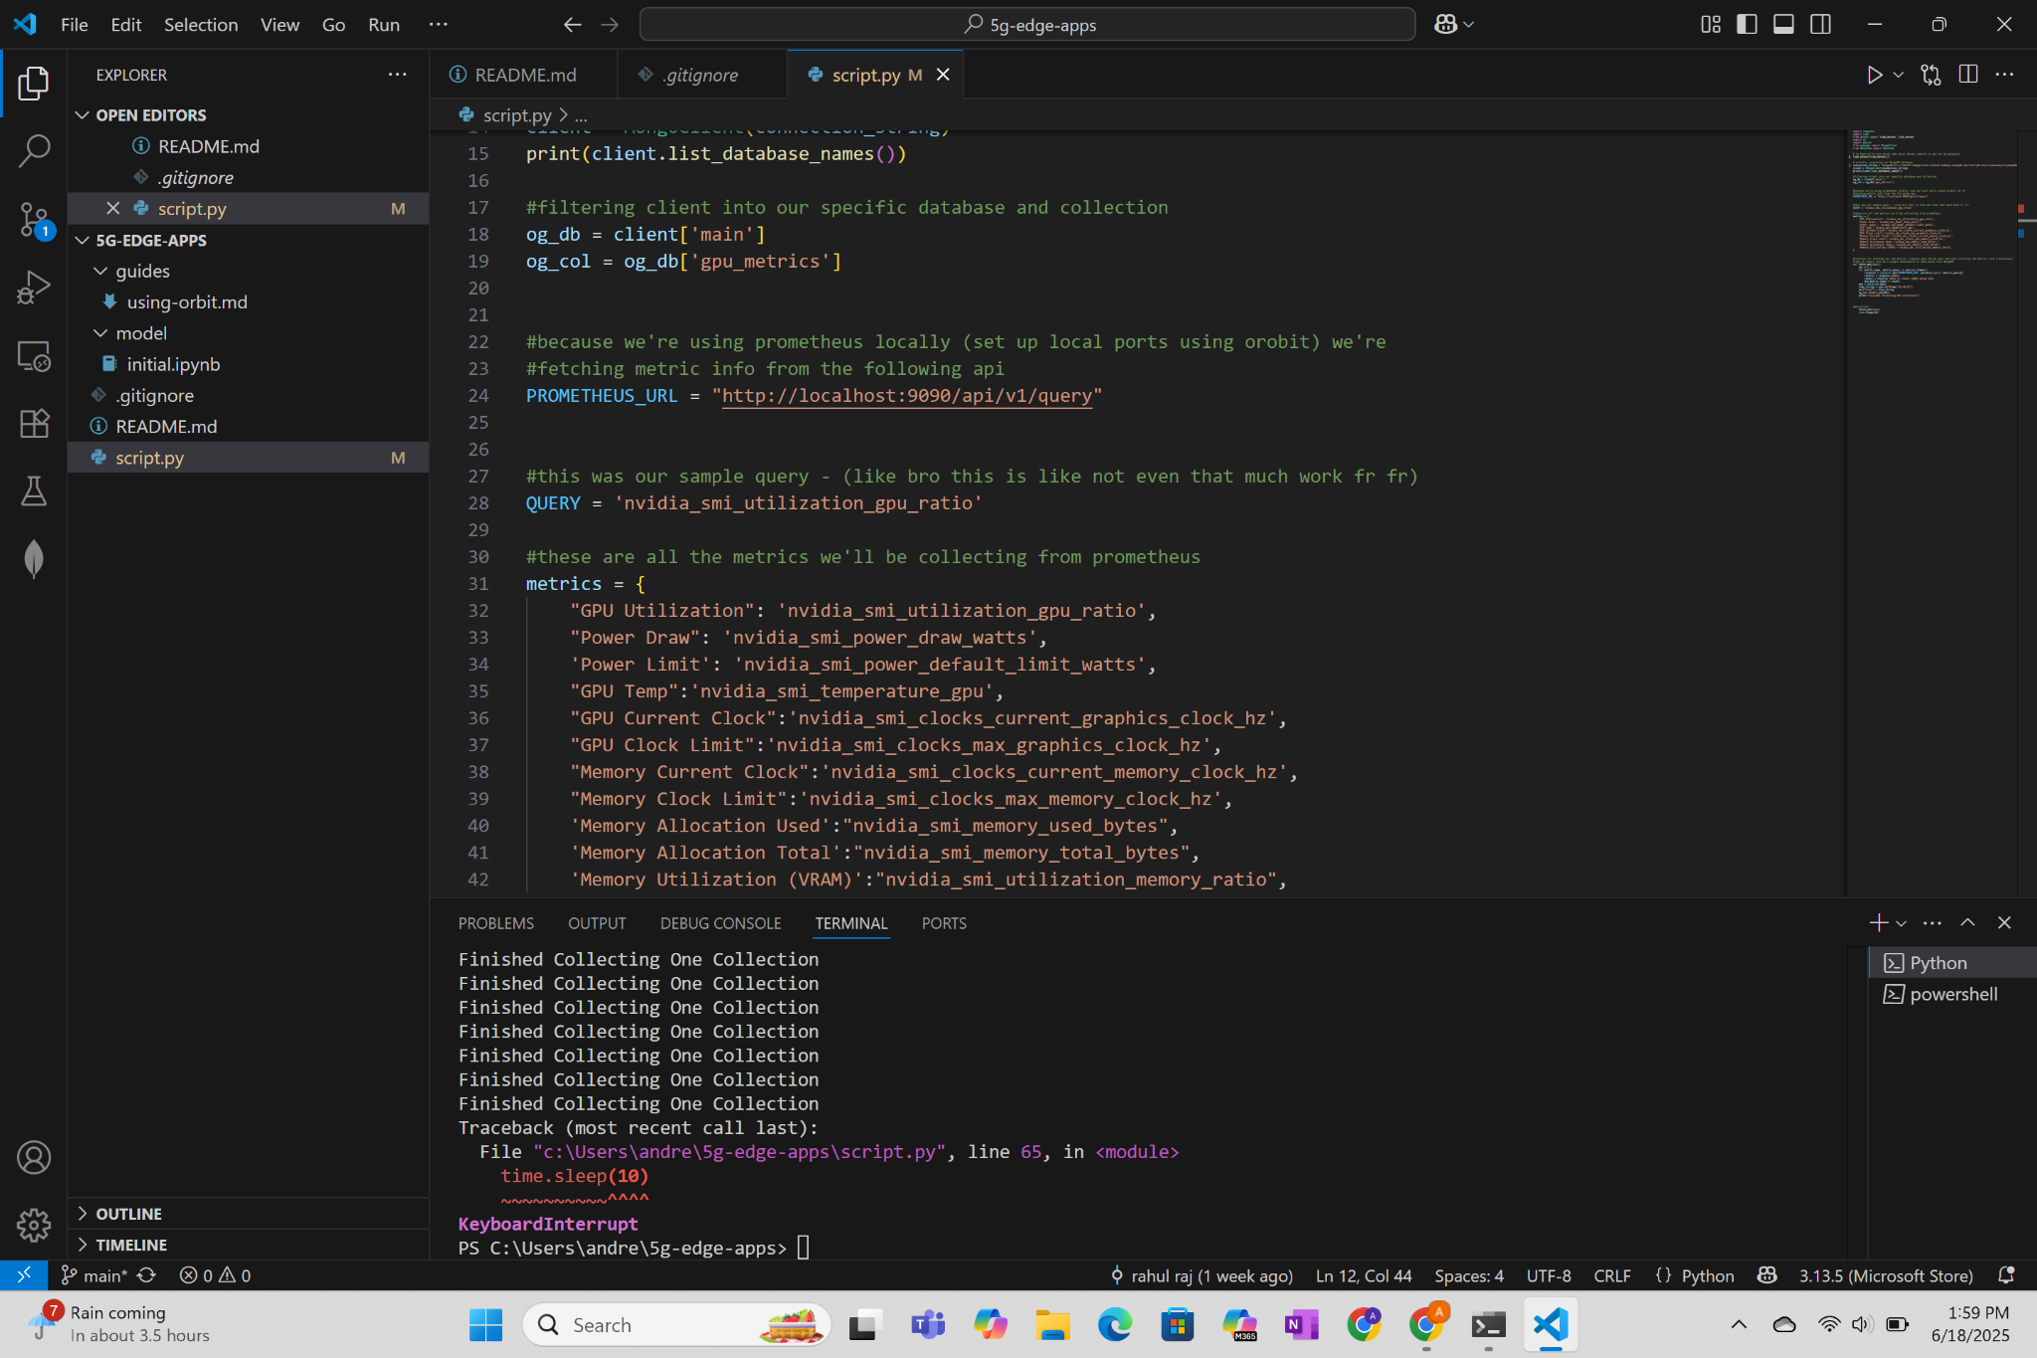
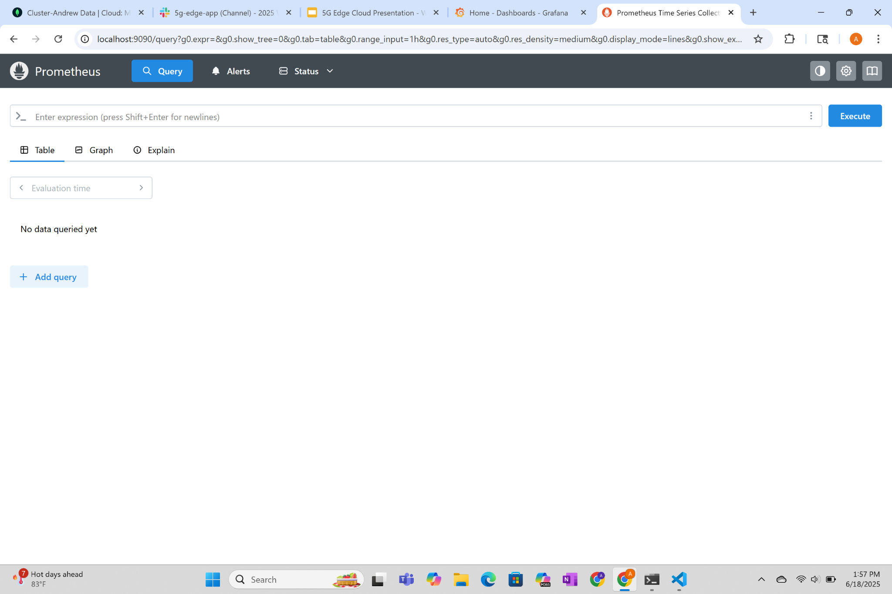
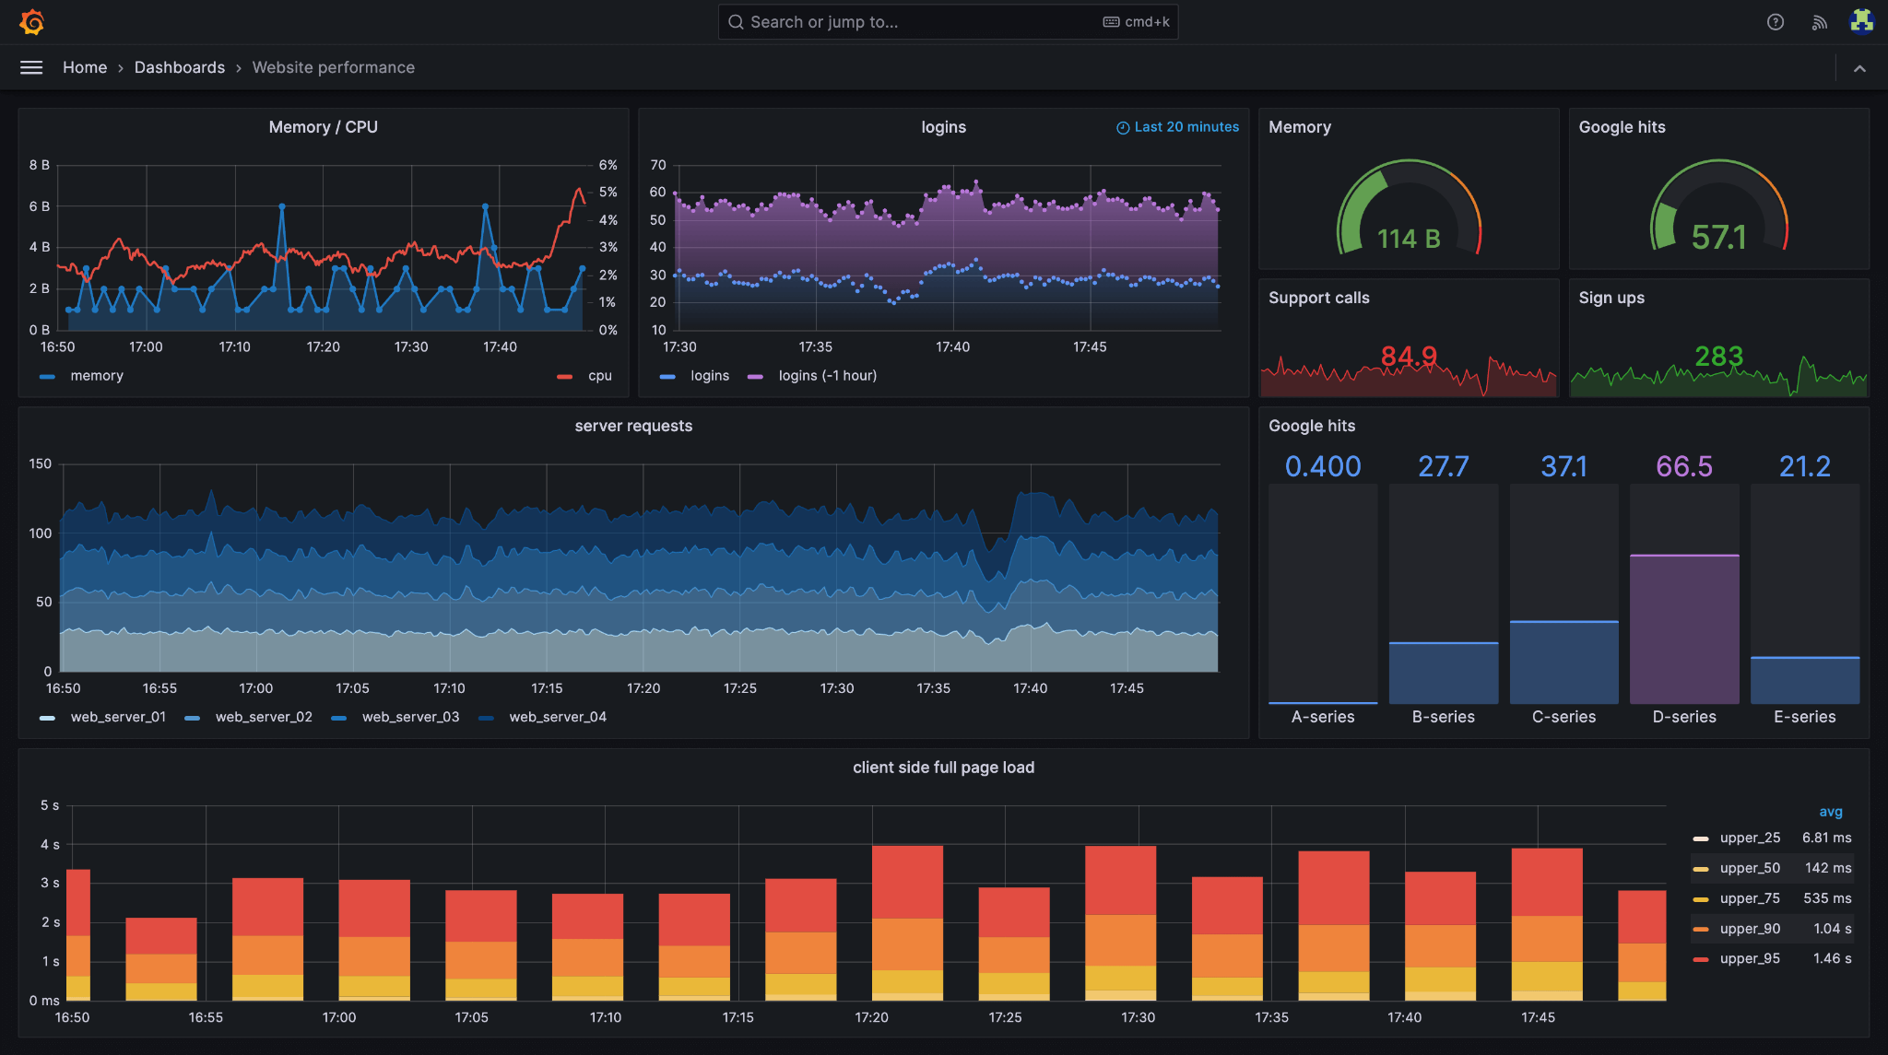



What we have done

Slide 5
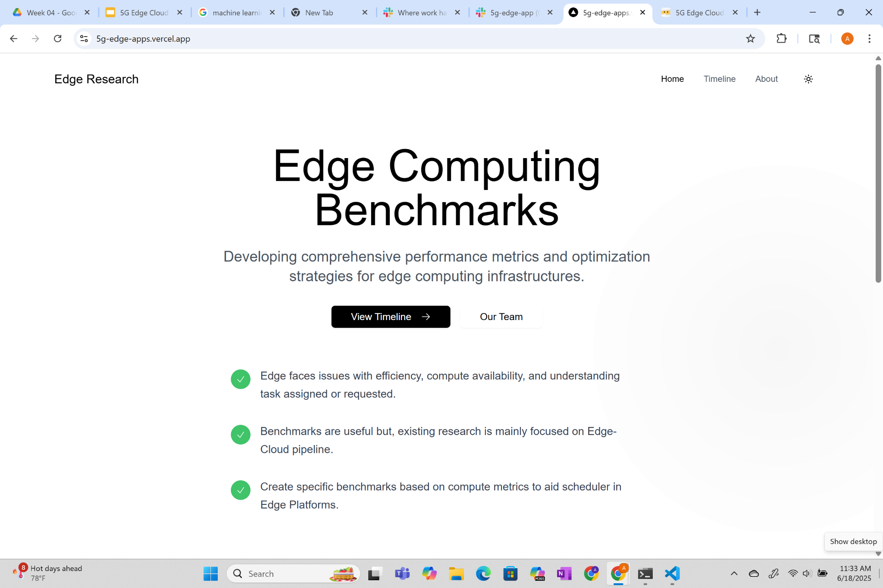
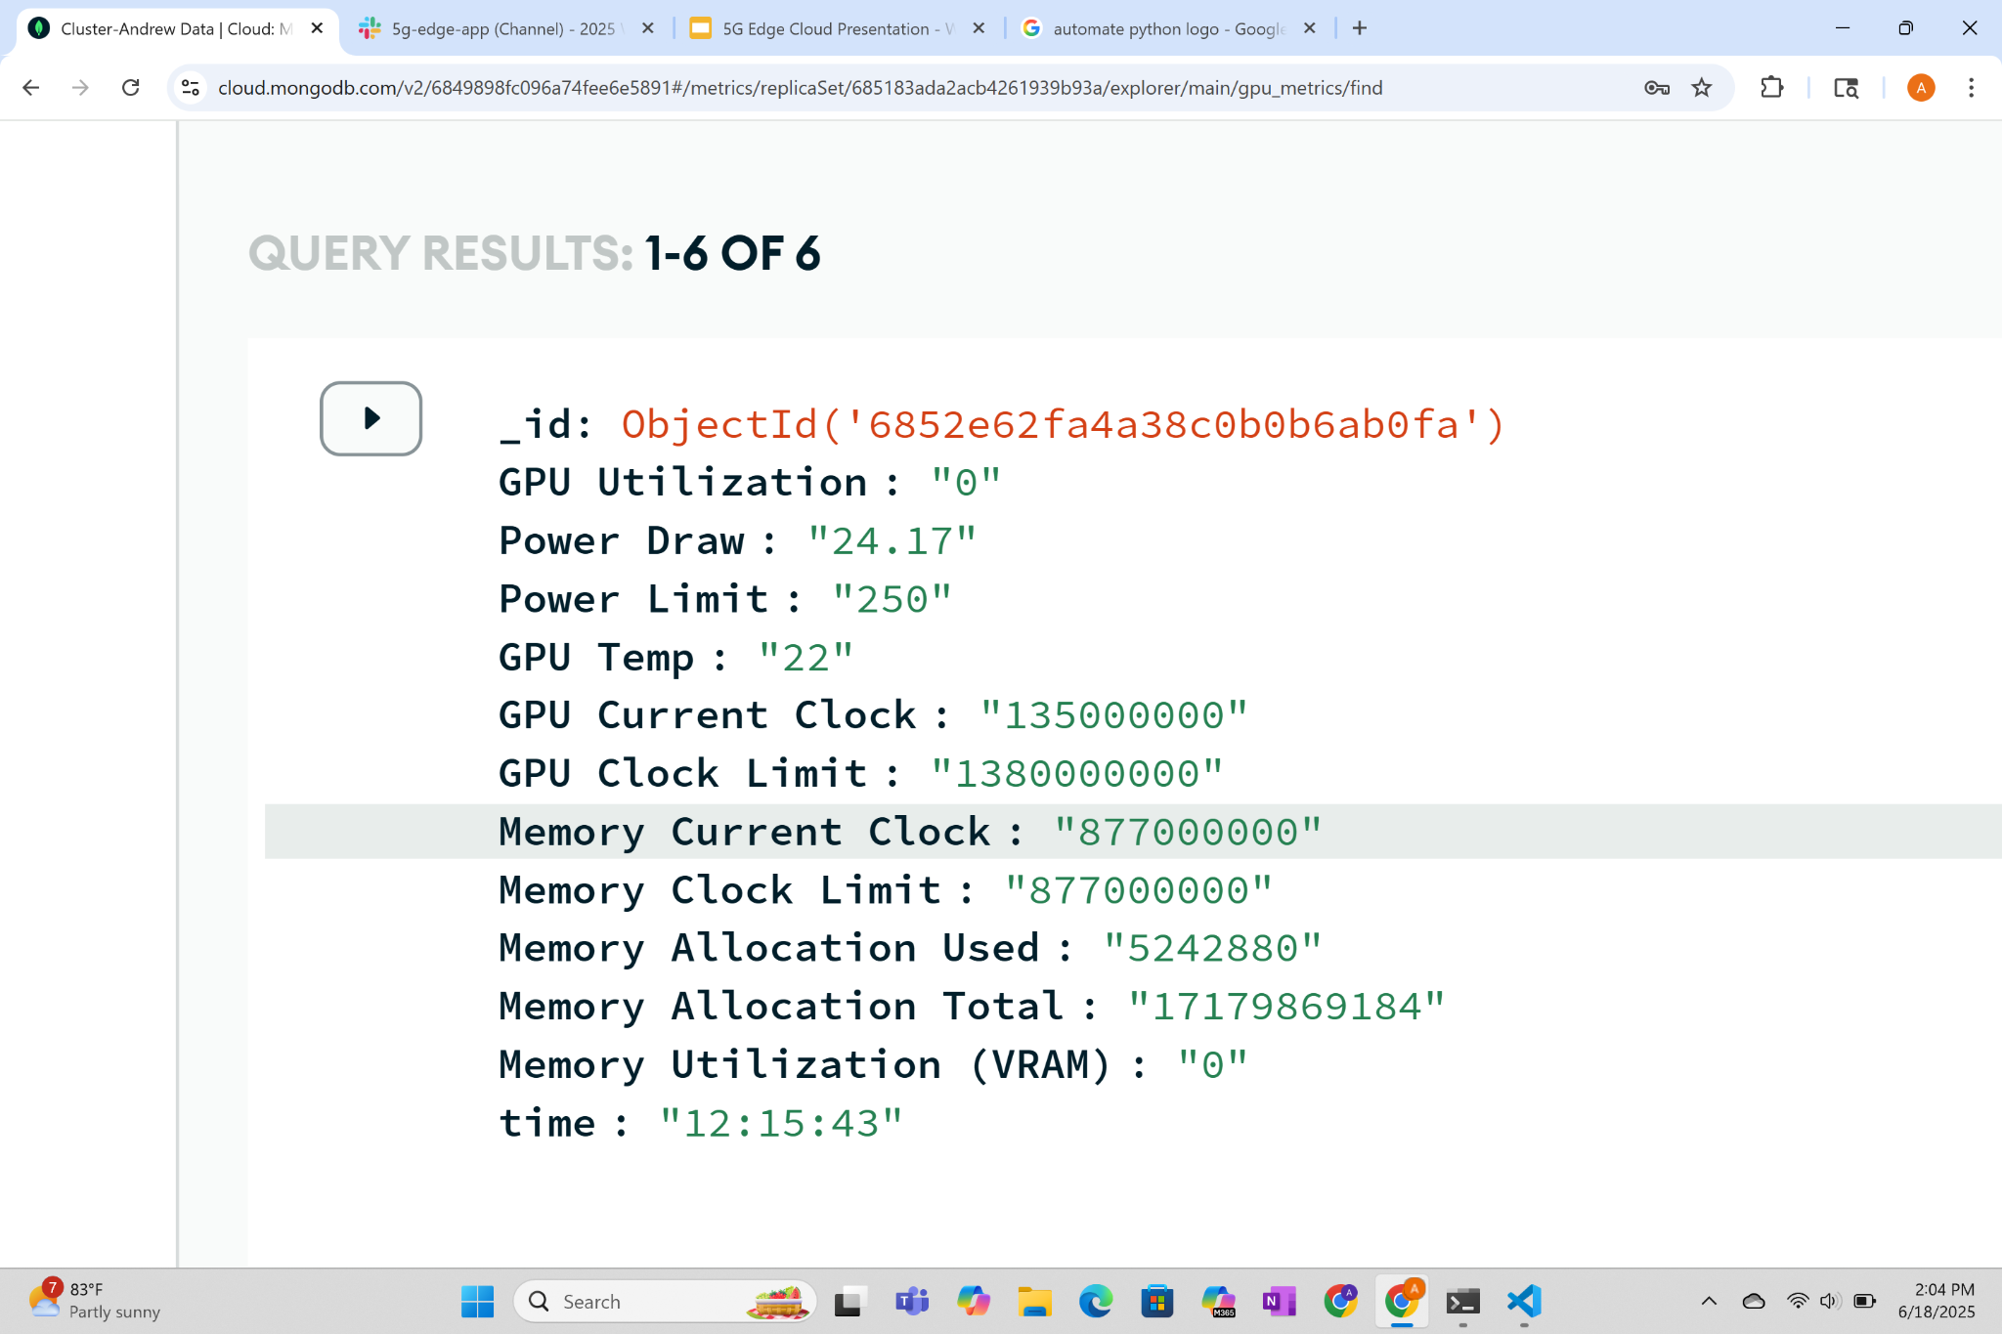
This week
Created Website
Prepared a standardized test
Collected sample data

Slide 6

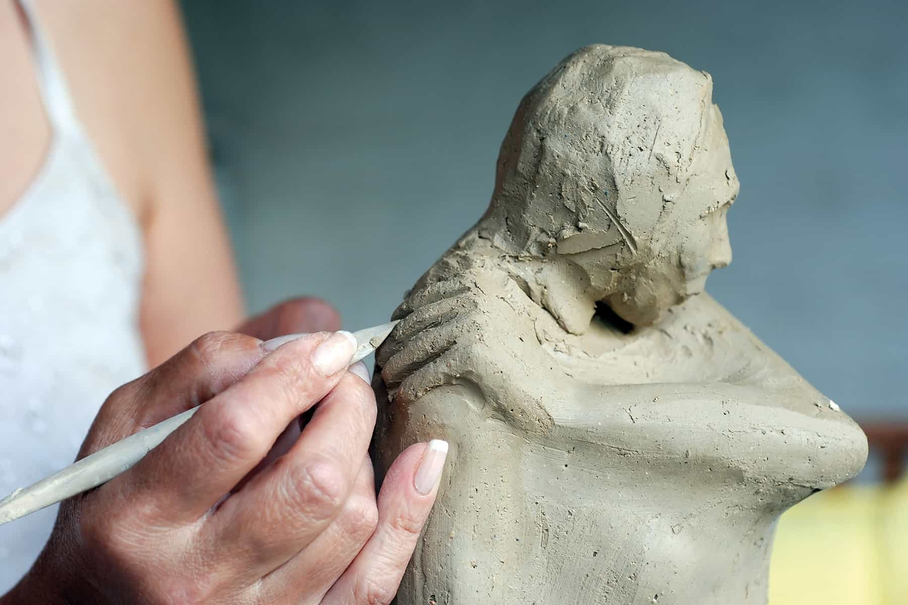
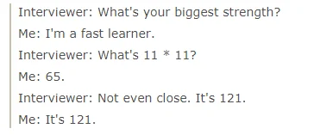
Upcoming Plans
1
2
Collect existing benchmarks
Create our benchmarks
Develop and train an ML model
3

Slide 7
Questions?
(we should know the answer)

